Slide 1

VR-Gaming to Broad
Participation in CS 1.0
Team Member: Daniel Perez Product Owner: Francisco Ortega
Instructor: Masoud Sadjadi School of Computing and Information Sciences Florida International University
Final Presentation
Spring 2018
Notes:
7 seconds.( I will select 2 best slides (i will give them extra points and students will present for CIS committee)
Greet your audience, thank them for attending your presentation, introduce yourself, introduce your project, introduce your team members, and quickly indicate what each of you did in a high-level manner, and put more emphasis on your part/contribution.

Slide 2

Project Definition
The computer science (CS) field is high in demand but there's a well-documented lack of gender and racial diversity.
Women, Blacks and Hispanics are underrepresented in obtaining CS degrees.
Educational institutions have attempted to make CS more appealing and accessible to these groups, yet the diversity gap endures.
Notes:
10 seconds.
Introduce the problem that the whole project (in all versions) tackles with GIF or screenshot.

Slide 3
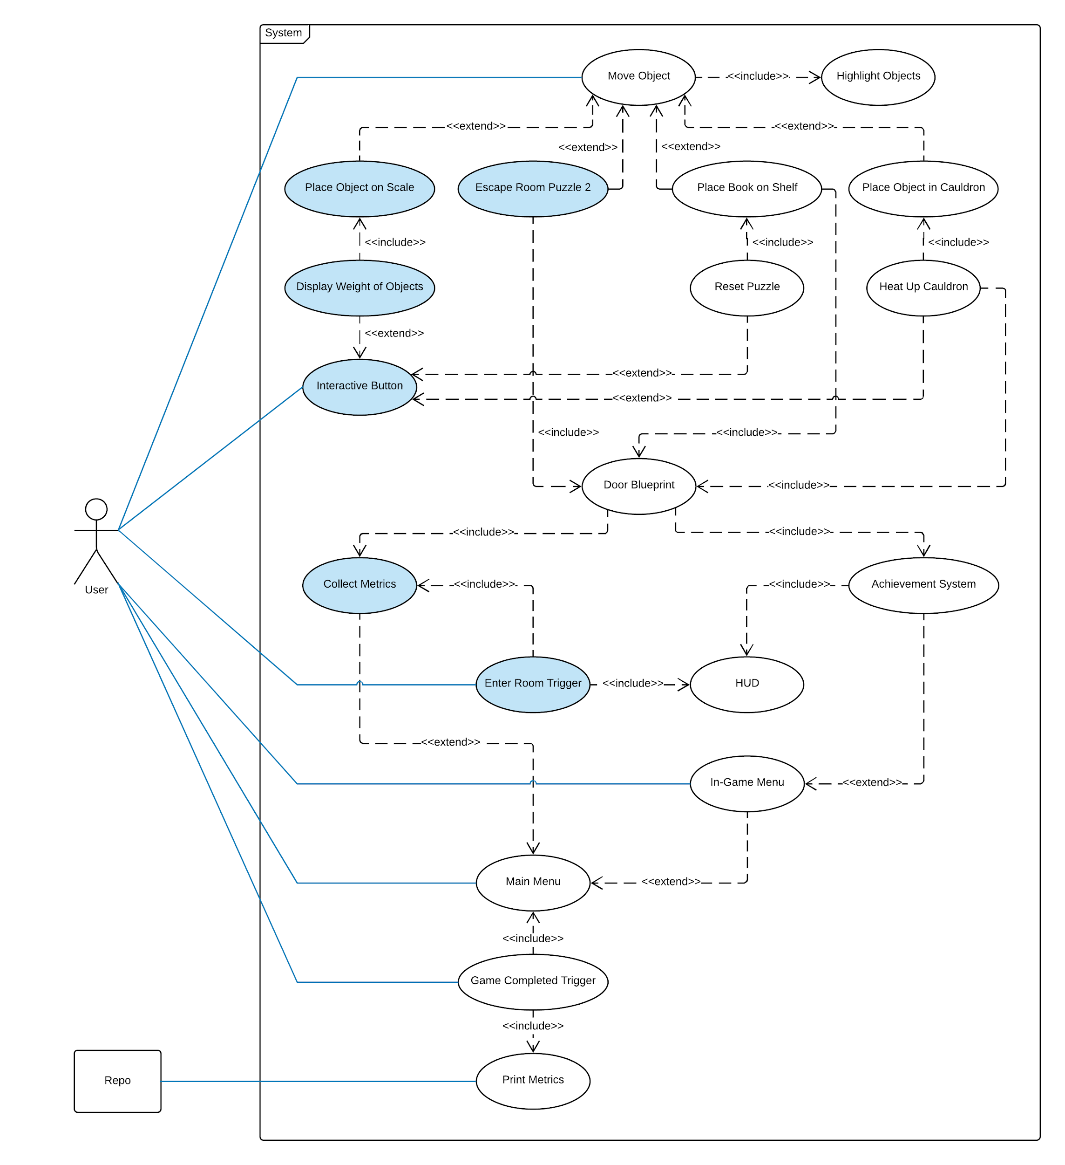
Requirements: Use Cases
Notes:
5 seconds
Show the Use Case Diagram for the whole project. Highlight your use cases.

Slide 4
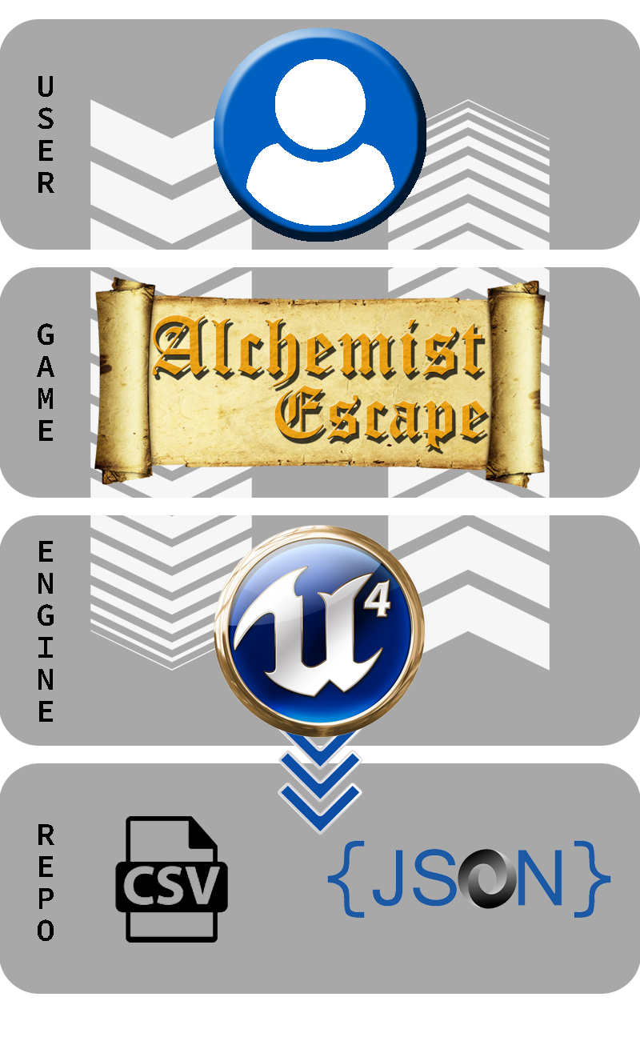
System Design: Architecture
Notes:
20 seconds
System design: Highlight the parts that you contributed to them.
1. System decomposition; identify the architecture patterns used
2. System deployment – h/w and s/w requirements

Slide 5
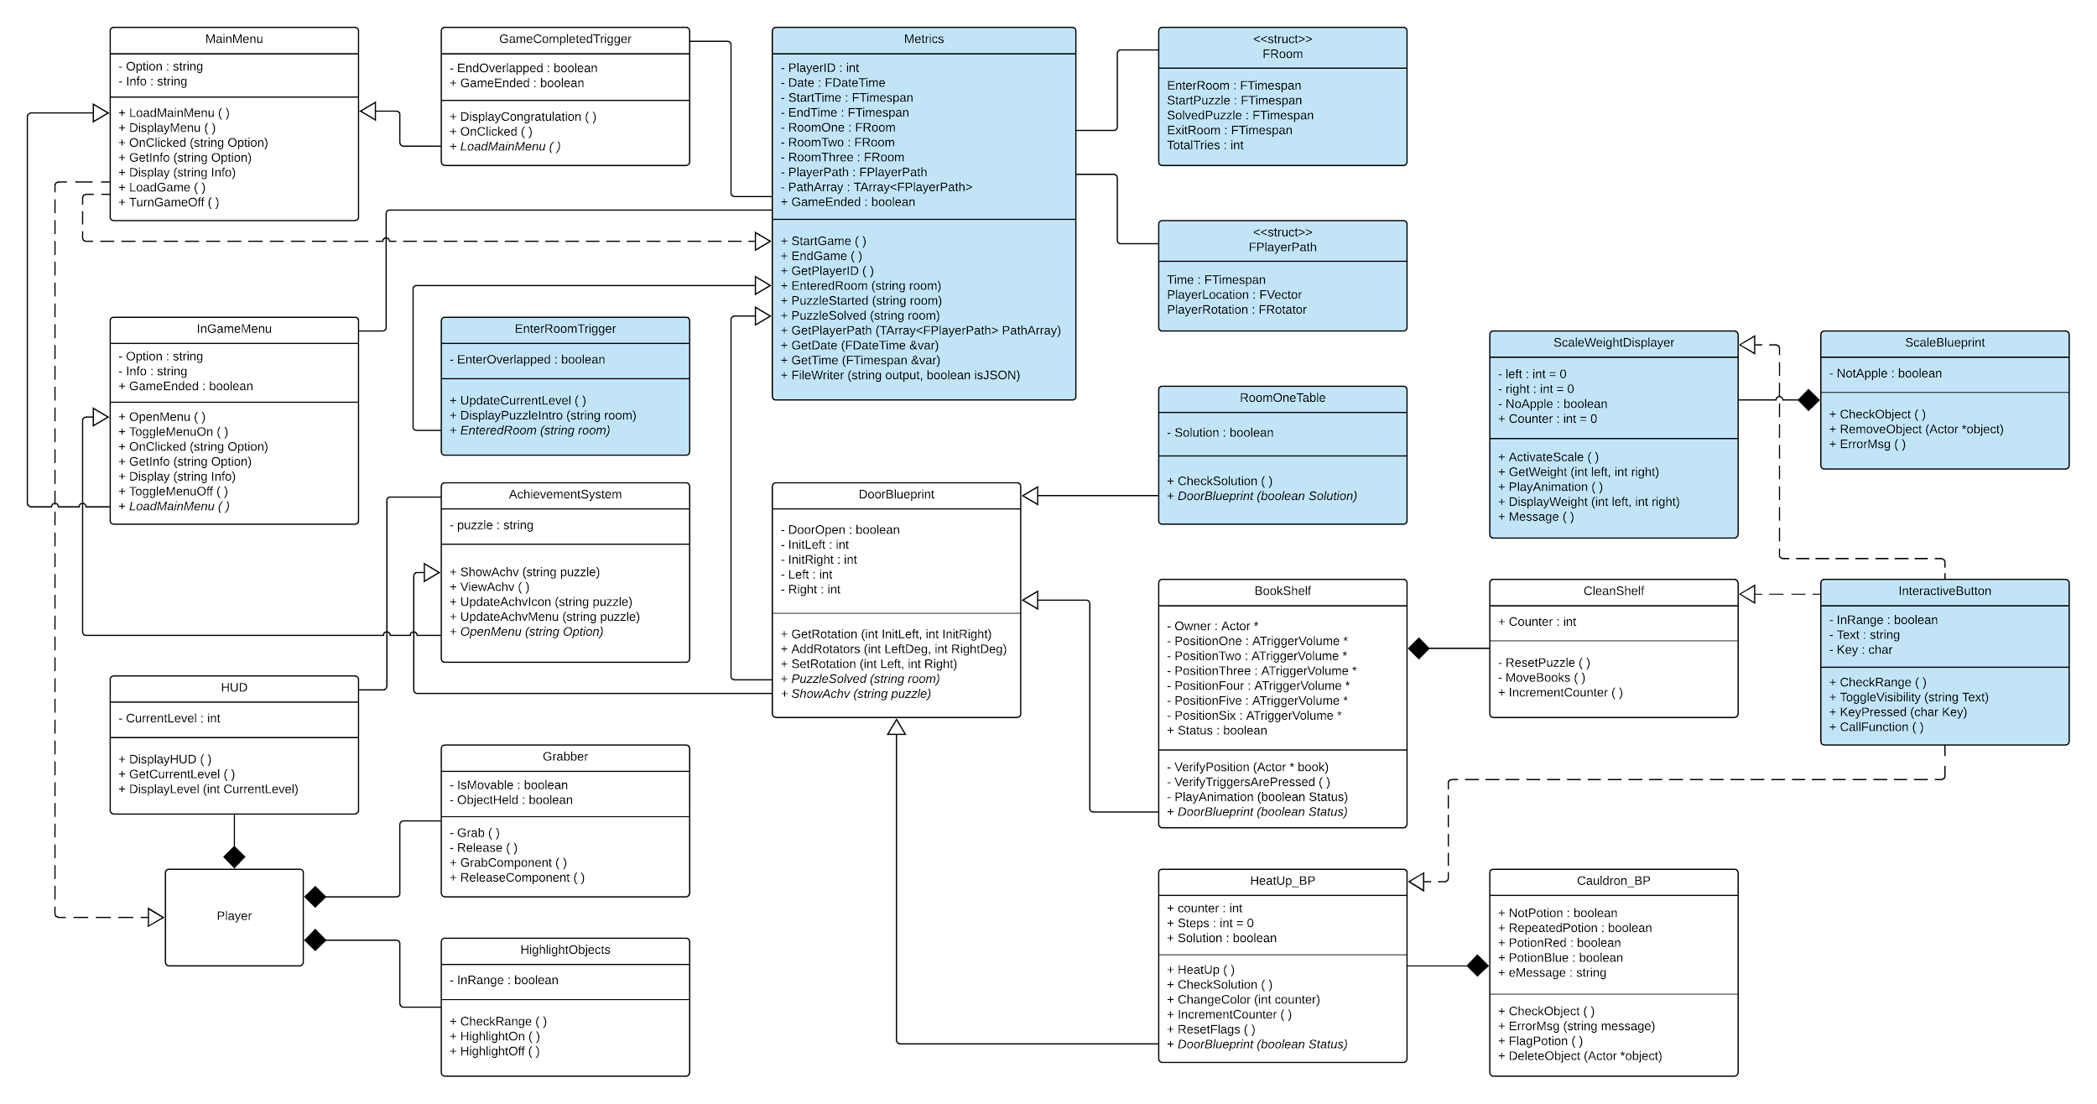
Minimal Class Diagram
Notes:
10 seconds.Minimal class diagram. Highlight the classes that you created/modified
Identify the design patterns used (one or more slides).

Slide 6
User Stories
1. Capture Data for Player Metrics
2. Interactive Button
3. Calculate Weight on Scale
4. Puzzle Completion
5. Enter Room Trigger
Notes:
5 seconds.
List the user stories that you worked on them.(put in order of importance). Stay focused on the parts that you have been working.

Slide 7
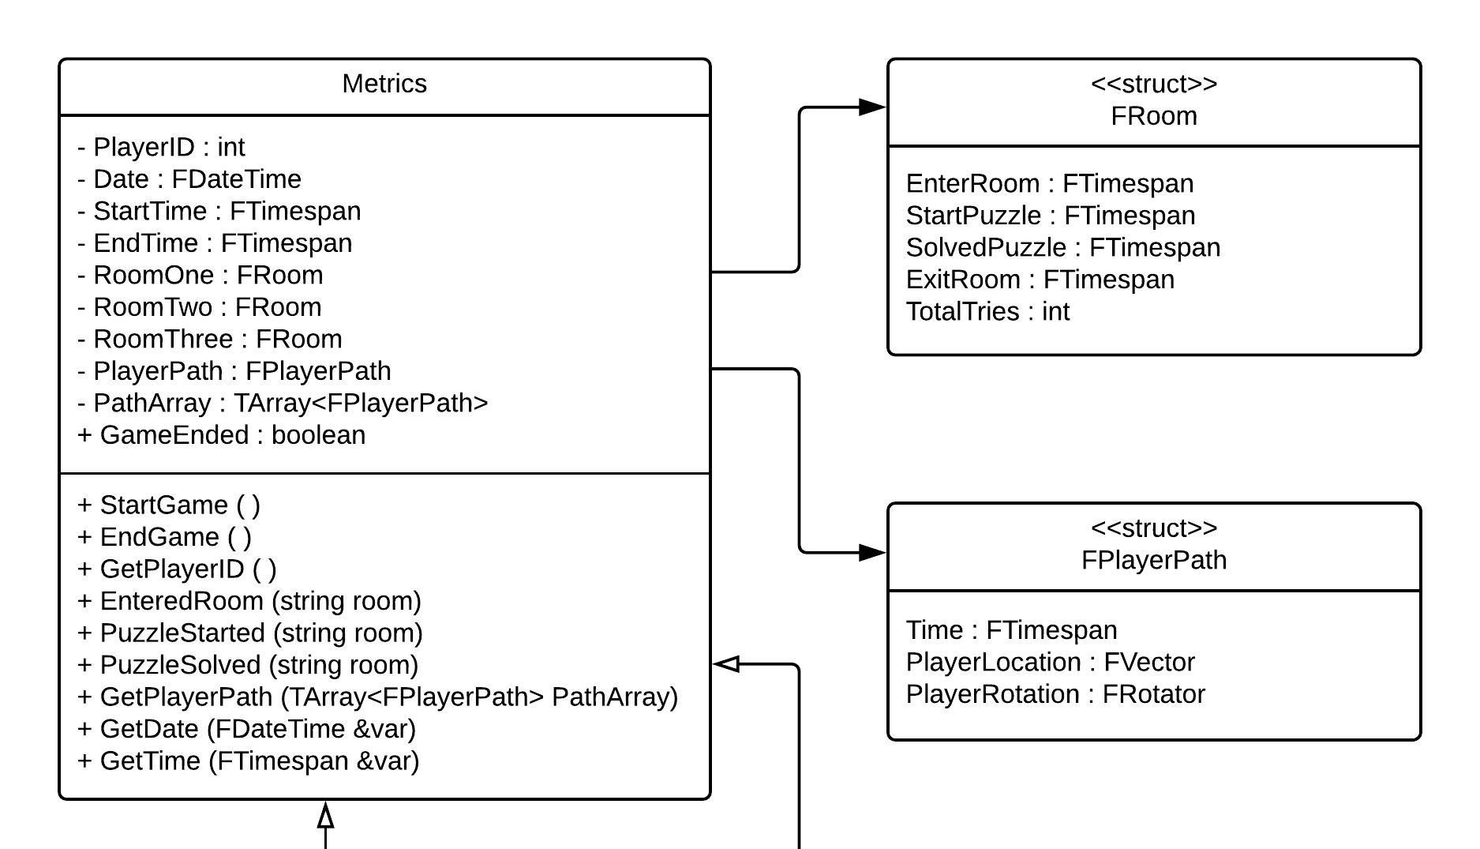
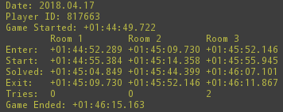
Capture Data for Player Metrics
Notes:
60 seconds
The tile of user story
The most important user story you worked on it. You have to describe this one very well and be proud of that.
Please present and show the complexity of your work, code, algorithms, and technical challenges and technologies you have used. (you could use screenshot if you want. Visual presentations are better than text presentation)
Go into the details of the most important/significant tasks using bullet lists or visual graphs or state chart diagram
Sequence Diagram for this user story is mandatory (in another separate page if required)
Demo using screenshots or GIF (in another separate page if required)

Slide 8
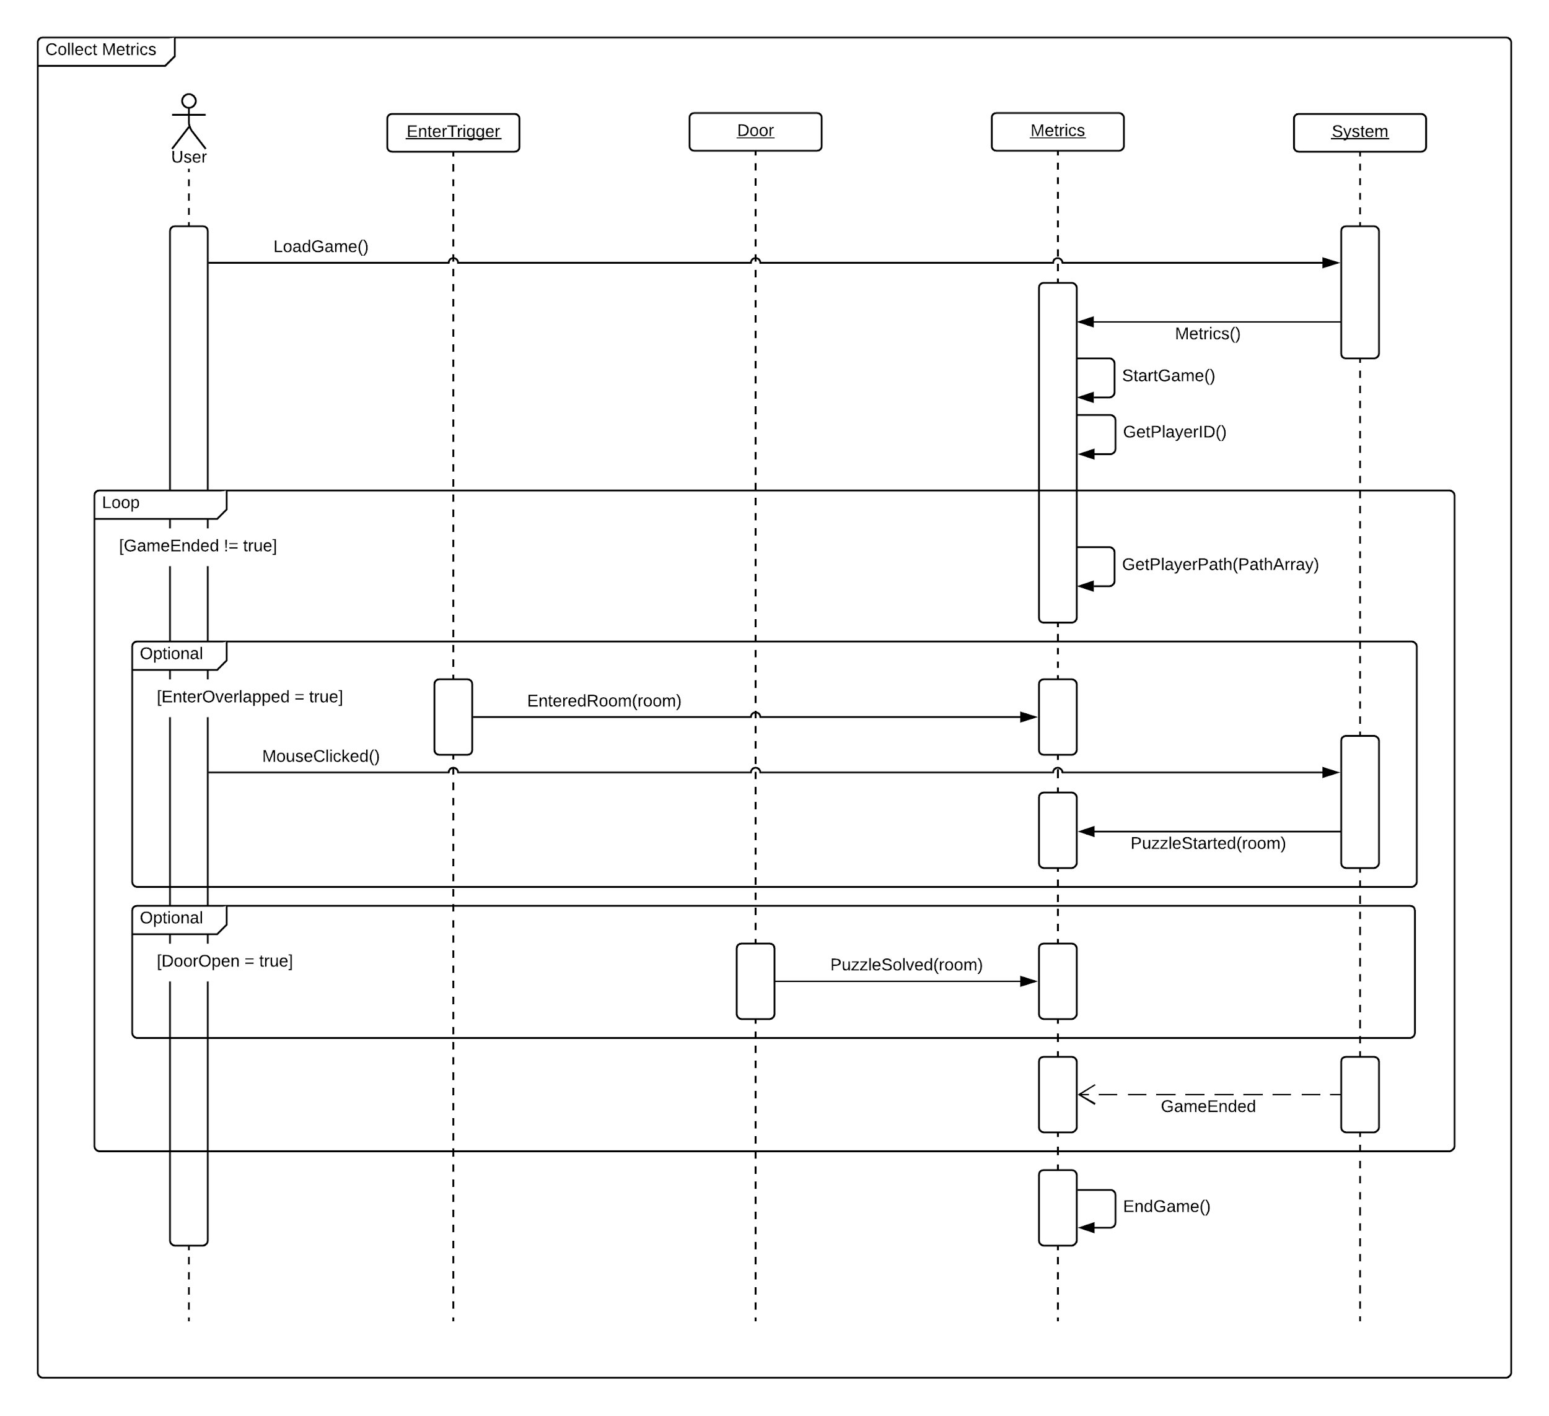
Capture Data for Player Metrics
Notes:
60 seconds
The tile of user story
The most important user story you worked on it. You have to describe this one very well and be proud of that.
Please present and show the complexity of your work, code, algorithms, and technical challenges and technologies you have used. (you could use screenshot if you want. Visual presentations are better than text presentation)
Go into the details of the most important/significant tasks using bullet lists or visual graphs or state chart diagram
Sequence Diagram for this user story is mandatory (in another separate page if required)
Demo using screenshots or GIF (in another separate page if required)

Slide 9
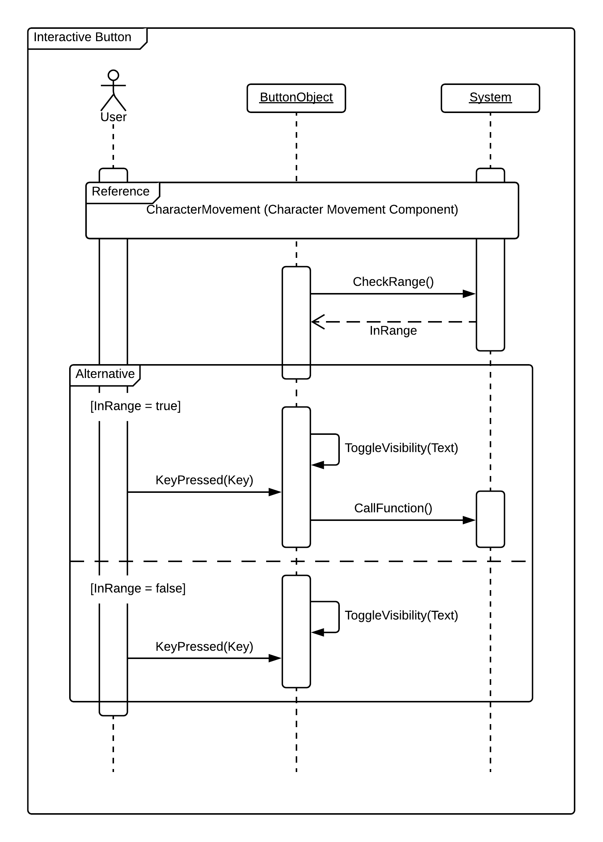
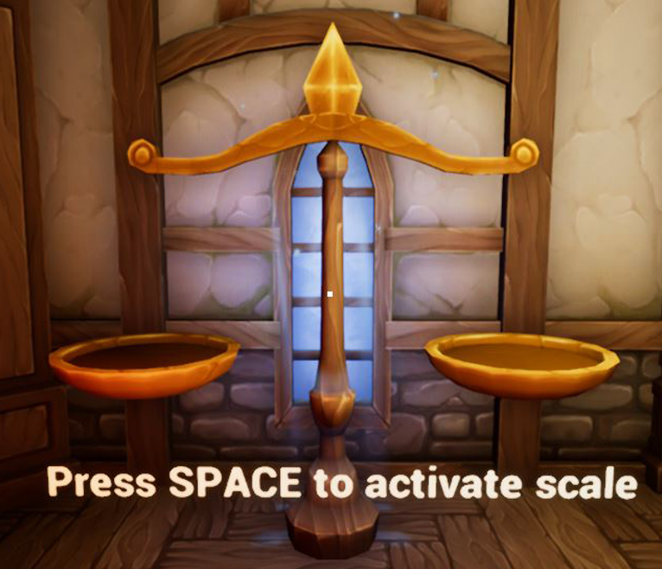
Interactive Button
Notes:
20 seconds
The tile of user story
Please present and show the complexity of your work, code, algorithms, and technical challenges and technologies you have used. (you could use screenshot if you want. Visual presentations are better than text presentation) - Go into the details of the most important/significant tasks using bullet lists or visual graphs or state chart diagram - Demo using screenshots or GIF (in another separate page if required)
Sequence Diagram for this user story is optional

Slide 10
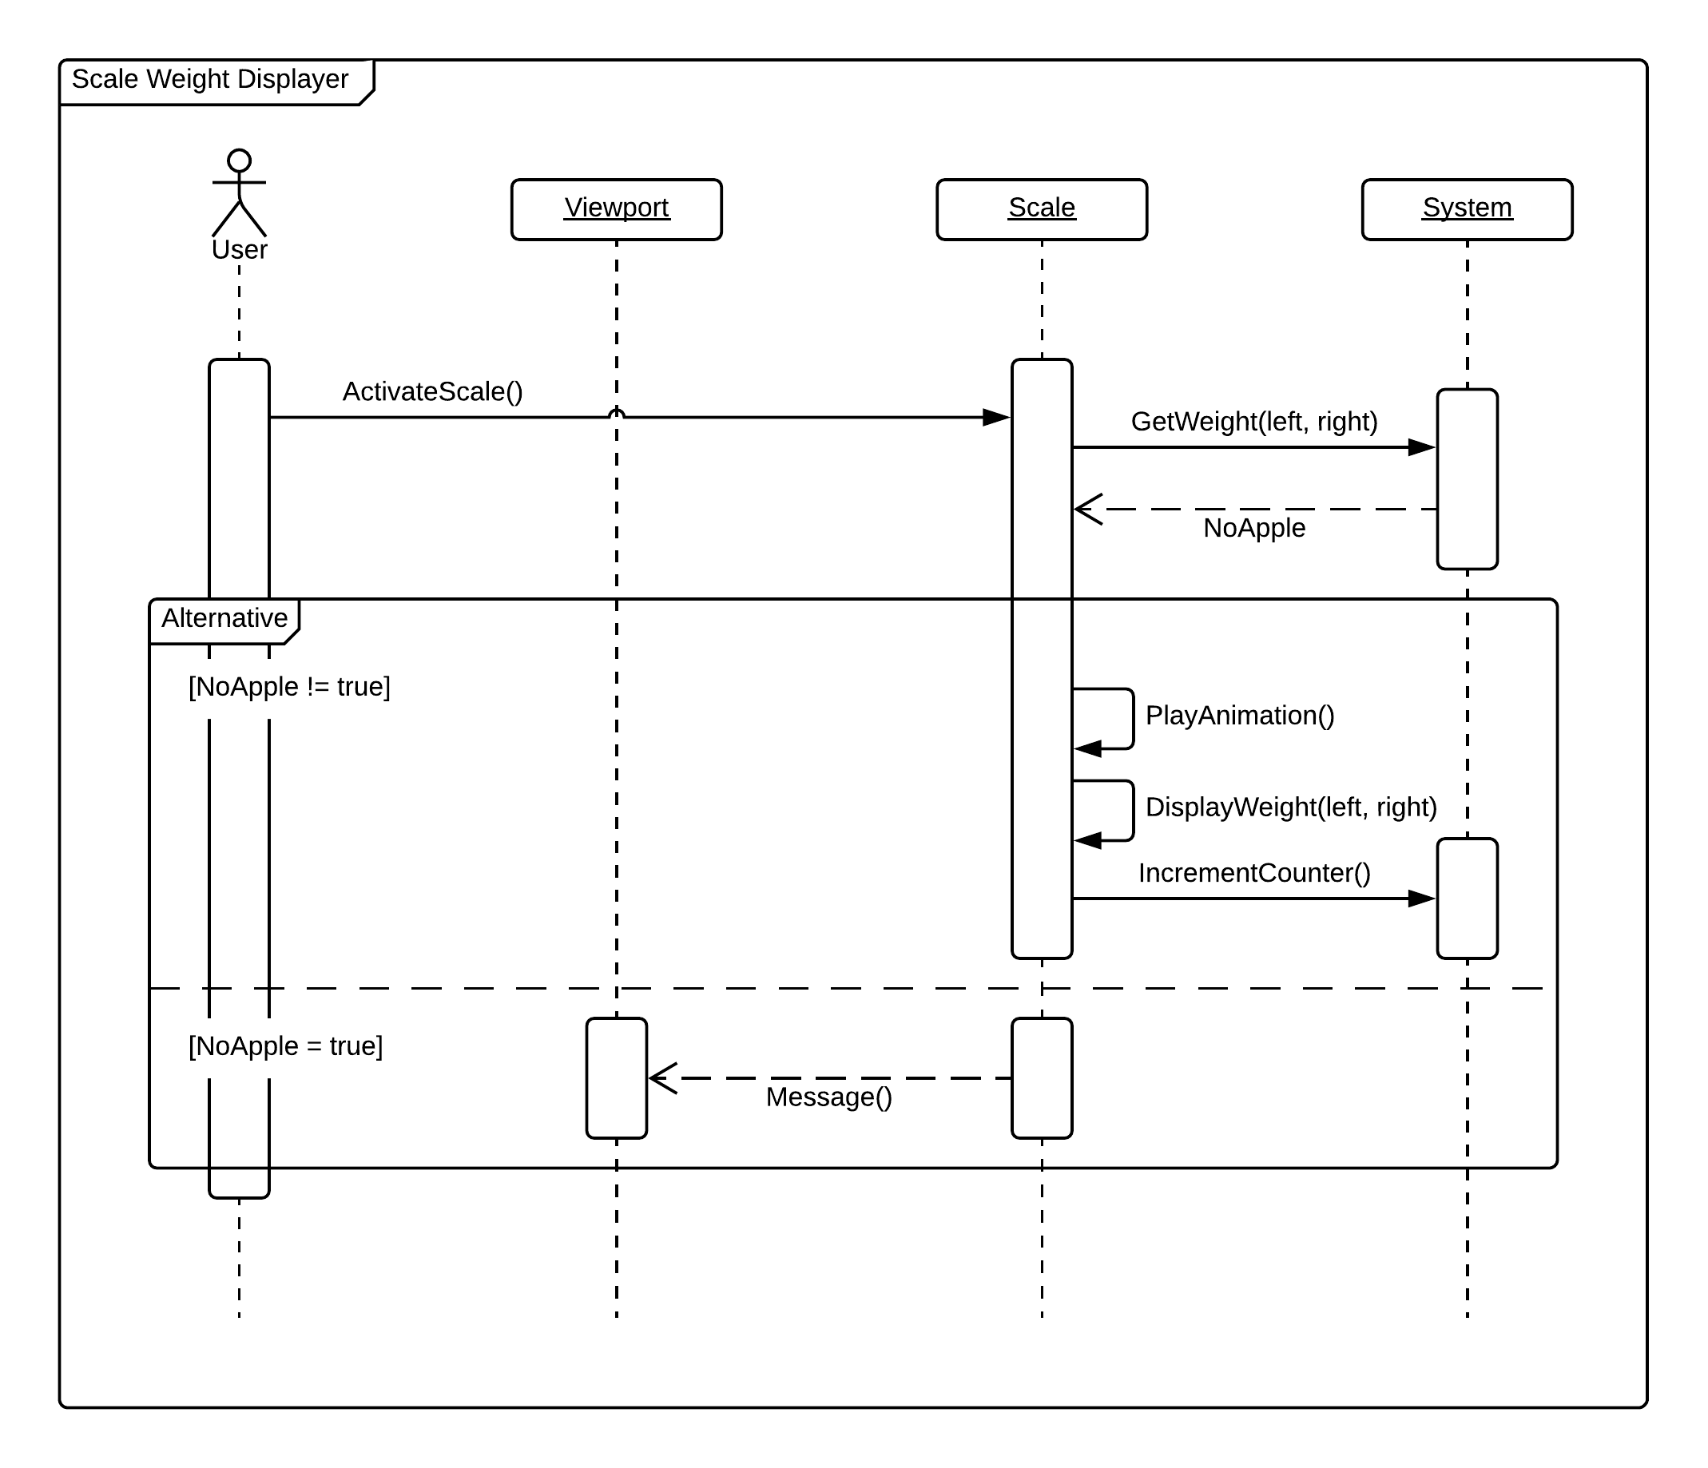
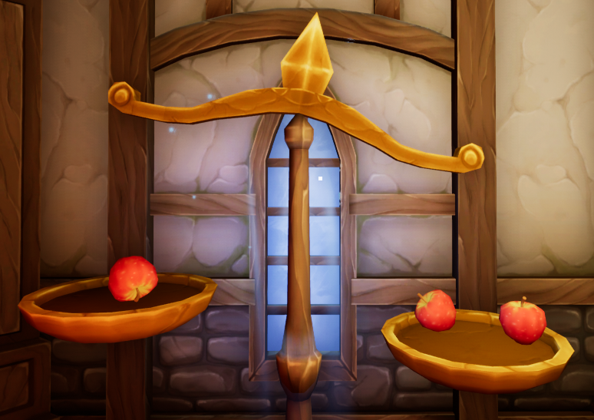
Calculate Weight on Scale
Notes:
20 seconds
The tile of user story
Please present and show the complexity of your work, code, algorithms, and technical challenges and technologies you have used. (you could use screenshot if you want. Visual presentations are better than text presentation) - Go into the details of the most important/significant tasks using bullet lists or visual graphs or state chart diagram - Demo using screenshots or GIF (in another separate page if required)
Sequence Diagram for this user story is optional

Slide 11
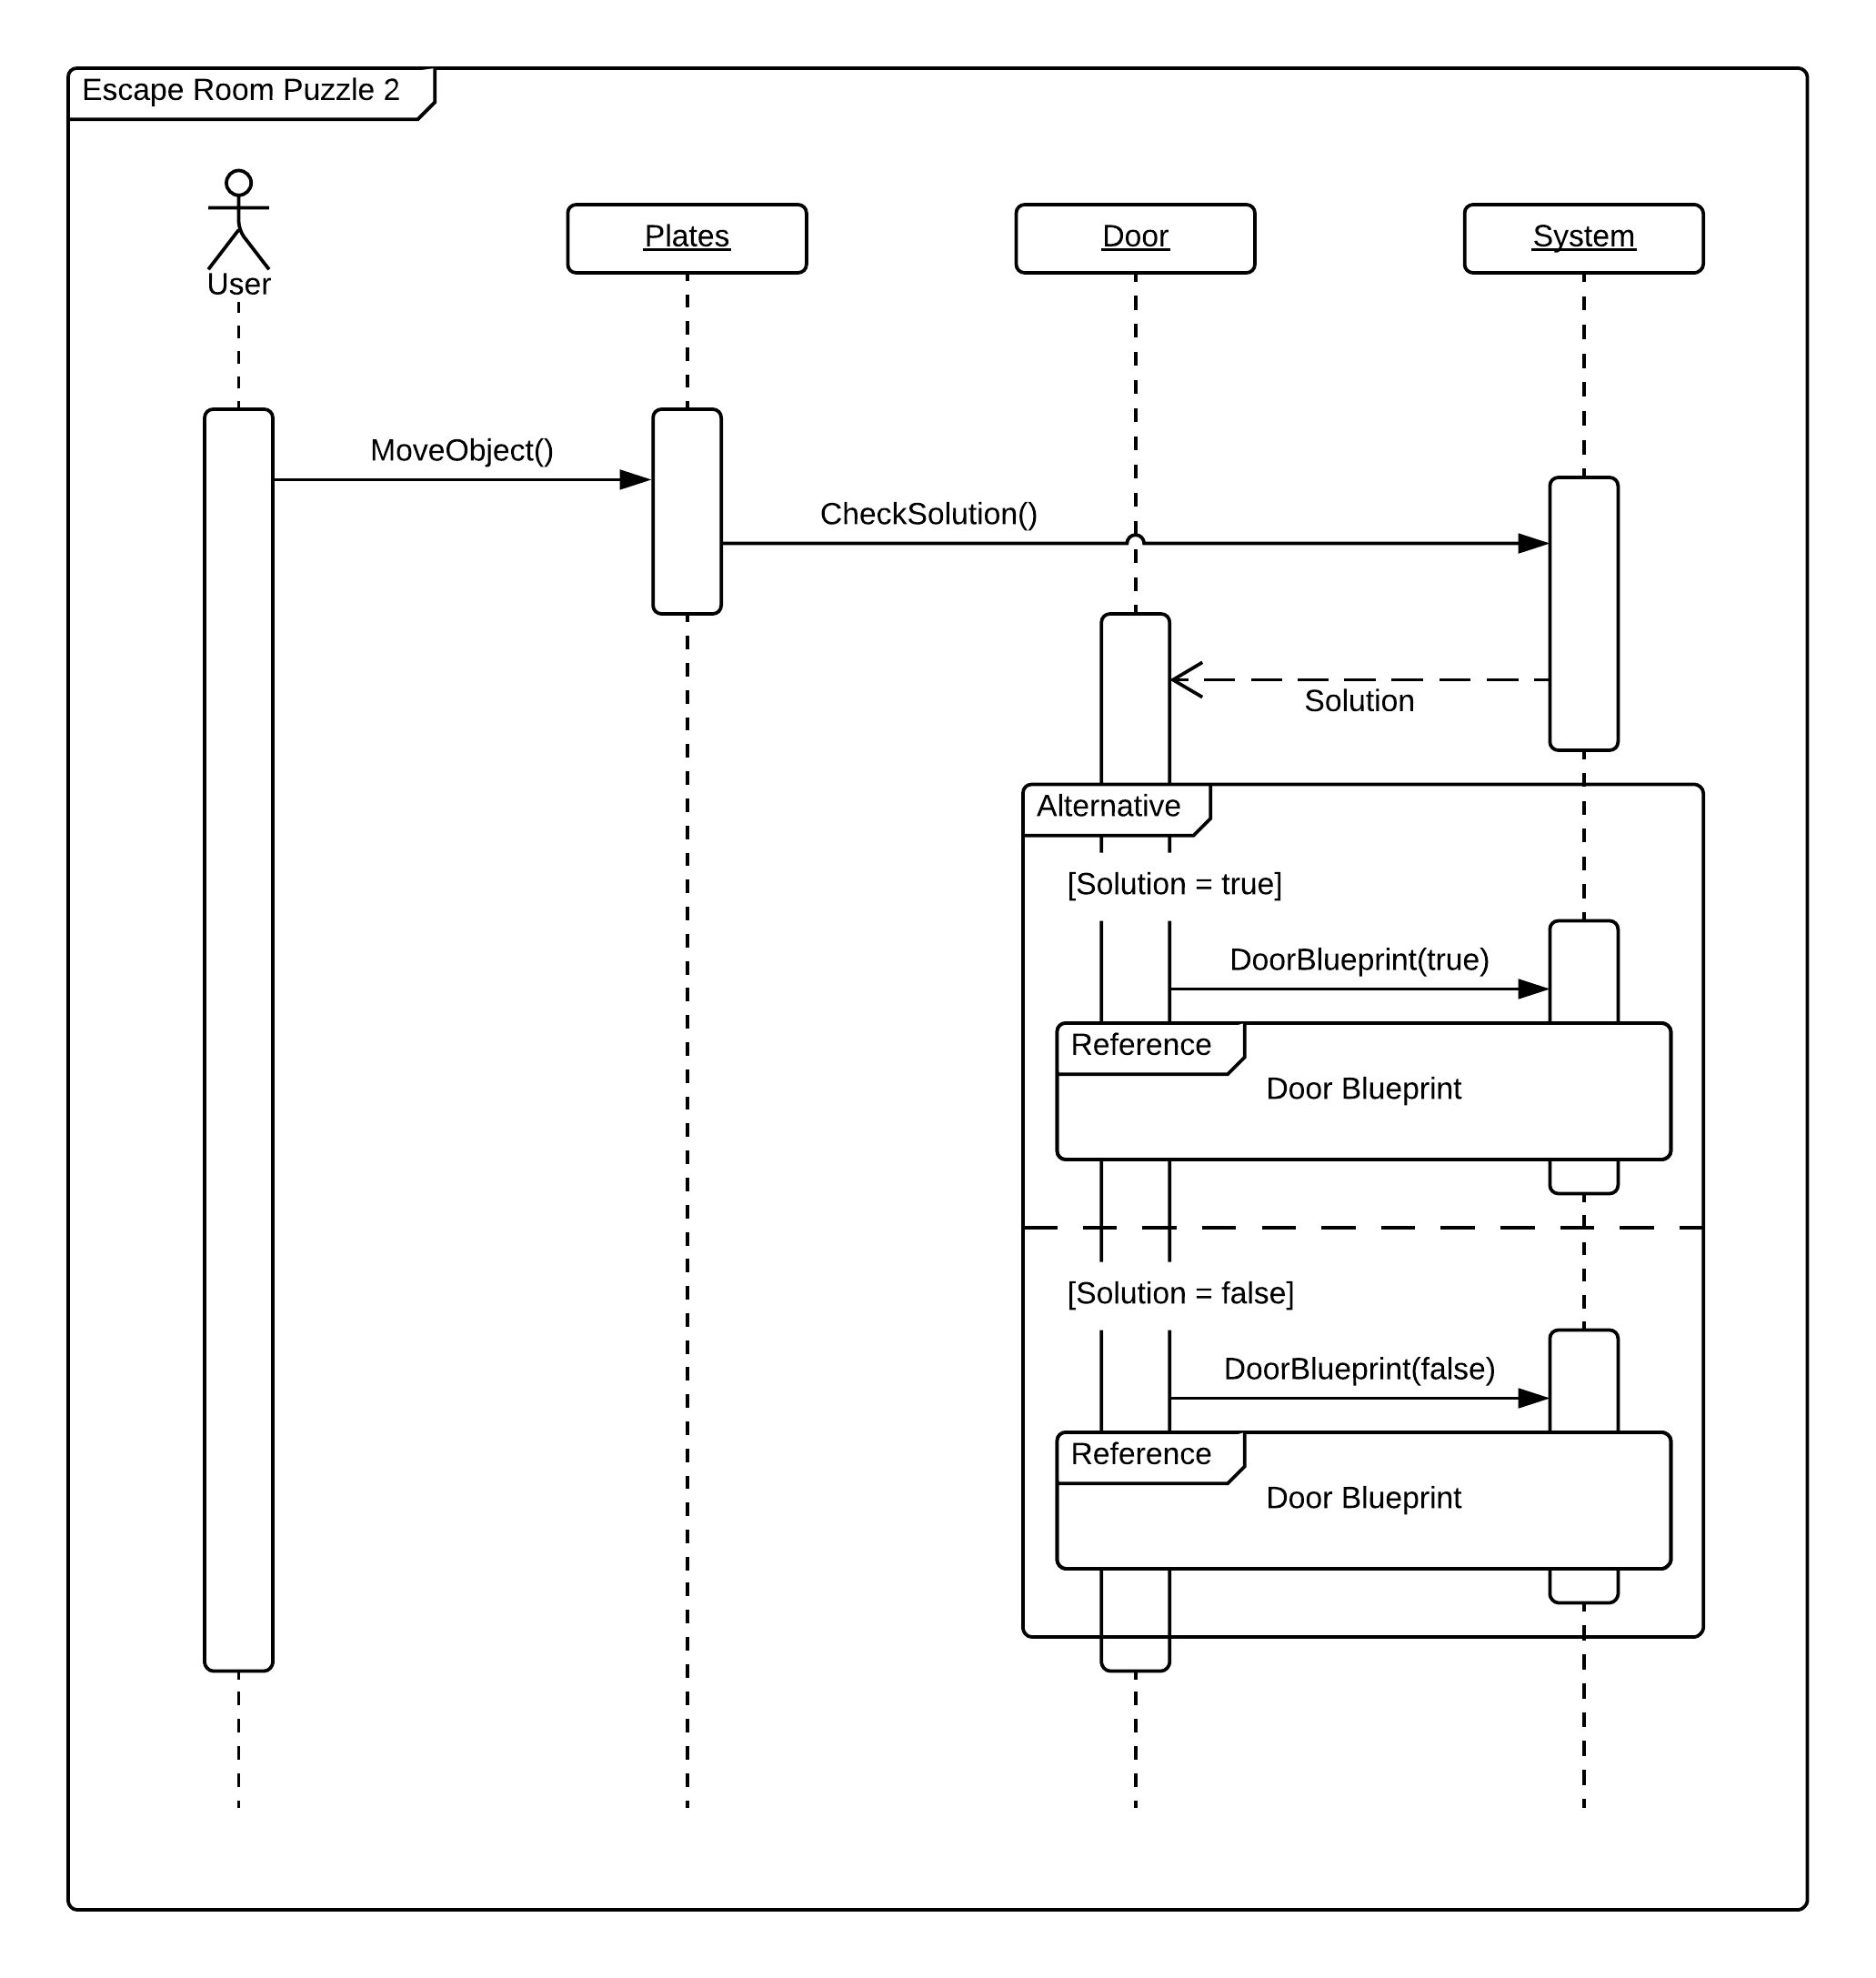
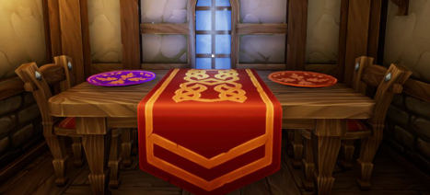
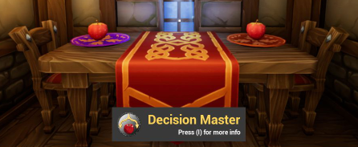
Puzzle Completion
Notes:
20 seconds
The tile of user story
Please present and show the complexity of your work, code, algorithms, and technical challenges and technologies you have used. (you could use screenshot if you want. Visual presentations are better than text presentation) - Go into the details of the most important/significant tasks using bullet lists or visual graphs or state chart diagram - Demo using screenshots or GIF (in another separate page if required)
Sequence Diagram for this user story is optional

Slide 12
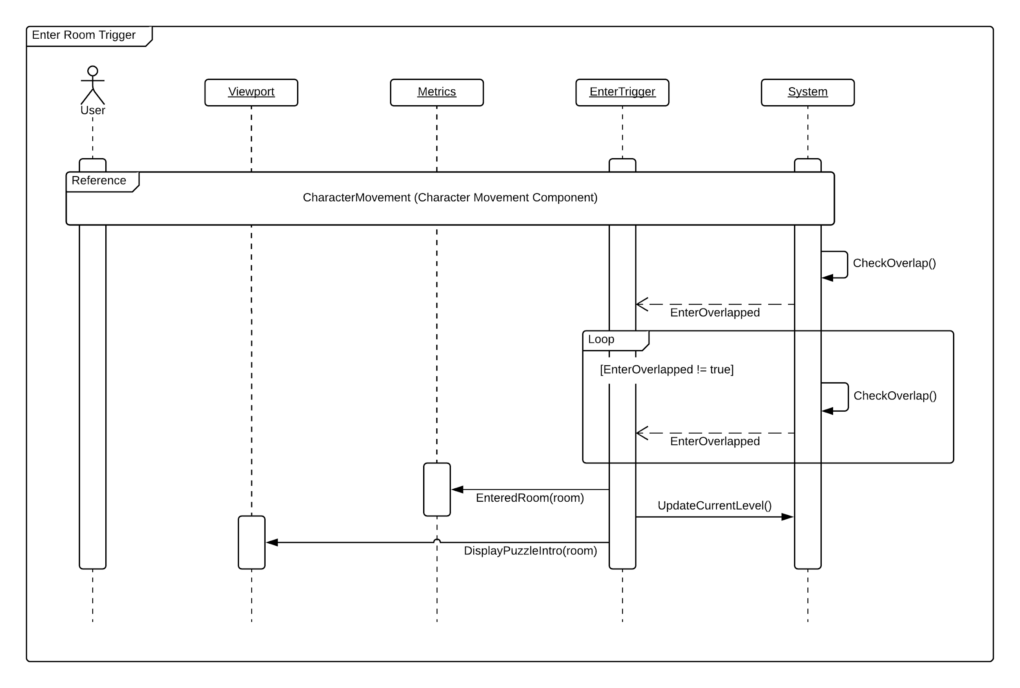
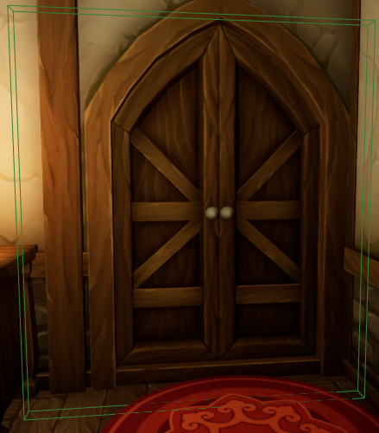
Enter Room Trigger
Notes:
20 seconds
The tile of user story
Please present and show the complexity of your work, code, algorithms, and technical challenges and technologies you have used. (you could use screenshot if you want. Visual presentations are better than text presentation) - Go into the details of the most important/significant tasks using bullet lists or visual graphs or state chart diagram - Demo using screenshots or GIF (in another separate page if required)
Sequence Diagram for this user story is optional

Slide 13
Test Suites and Test Cases
Unit Test
Test case ID: metrics_start
Description/Summary of Test: Metrics start collecting data when the player clicks on start game.
Pre-condition: Player clicks on the “start game” button.
Expected Results: The metrics begin recording data.
Actual Result: The metrics began recording data.
Status (Fail/Pass): Pass
Test case ID: generate_id
Description/Summary of Test: Generate a unique player ID at the start of the game.
Pre-condition: The game is started.
Expected Results: Generates a unique player id.
Actual Result: A unique player id was generated.
Status (Fail/Pass): Pass
Test case ID: collect_date_and_time
Description/Summary of Test: The date and time that the game is started is recorded.
Pre-condition: The game is started.
Expected Results: The date and time is recorded.
Actual Result: The date and time was recorded.
Status (Fail/Pass): Pass
Notes:
10 seconds
A description of verification process and Test Suites and Test Cases for one of the use cases.
1 One sunny day and one rainy day for the implemented use cases (one or more slides).
2 Automated test scripts for the implemented use cases (if any) (one or more slides).

Slide 14
Test Suites and Test Cases
Test case ID: collect_time_room_entered
Description/Summary of Test: The time for when a room is entered is collected.
Pre-condition: The player enters a room.
Expected Results: The entered room time is collected.
Actual Result: The entered room time was collected.
Status (Fail/Pass): Pass
Test case ID: collect_time_puzzle_started
Description/Summary of Test: The time for when a puzzle is started is collected.
Pre-condition: The player starts the puzzle.
Expected Results: The puzzle started time is collected.
Actual Result: The puzzle started time was collected.
Status (Fail/Pass): Pass
Test case ID: collect_time_puzzle_solved
Description/Summary of Test: The time for when a puzzle is solved is collected.
Pre-condition: The player solves the puzzle.
Expected Results: The puzzle solved time is collected.
Actual Result: The puzzle solved time was collected.
Status (Fail/Pass): Pass
Notes:
10 seconds
A description of verification process and Test Suites and Test Cases for one of the use cases.
1 One sunny day and one rainy day for the implemented use cases (one or more slides).
2 Automated test scripts for the implemented use cases (if any) (one or more slides).

Slide 15
Test Suites and Test Cases
Test case ID: collect_time_room_exited
Description/Summary of Test: The time for when a room is exited is collected.
Pre-condition: The player exits a room.
Expected Results: The exited room time is collected.
Actual Result: The exited room time was collected.
Status (Fail/Pass): Pass
Test case ID: collect_total_number_of_tries
Description/Summary of Test: The number of attempts made to solve the puzzle is collected.
Pre-condition: The player solved the puzzle.
Expected Results: The total number of tries is collected.
Actual Result: The total number of tries was collected.
Status (Fail/Pass): Pass
Test case ID: record_player_location_rotation
Description/Summary of Test: Players location and rotation is being collected every second.
Pre-condition: The game is started.
Expected Results: Payers location and rotation gets collected every second.
Actual Result: Players location and rotation is collected every second.
Status (Fail/Pass): Pass
Notes:
10 seconds
A description of verification process and Test Suites and Test Cases for one of the use cases.
1 One sunny day and one rainy day for the implemented use cases (one or more slides).
2 Automated test scripts for the implemented use cases (if any) (one or more slides).

Slide 16








Summary
The purpose of Alchemist Escape is to offer an entertaining game that increases CS interest and awareness. Players can learn about CS concepts through gameplay, without the need of having any CS knowledge.
Email: dpere103@fiu.edu
Questions?
Thank You!
Notes:
10 seconds
Summarize your contribution, mention your effort for Scrum, Mingle, Github, Google Drive Documentation and minutes
Include your contact information
Ask if anyone has any questions for you.
Thank your audience

